Slide 1
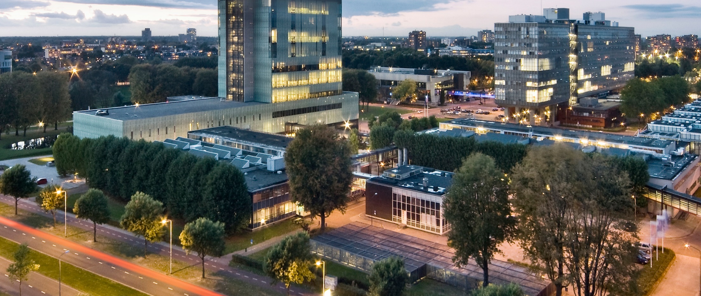
Minimum time control of a simple 2D double integrator model
Homework 2 Assignment 5
Group 2
Optimal Control and Dynamic Programming

Slide 2
Main idea
The main focus was to ensure that the model inputs and outputs did not violate its boundaries.
This is done using MPC, whereby the input and output of the model are bounded using inequality constraints.
The used cost function only looks at the tracking error and does not weigh the input.
To implement this in MATLAB, the function quadprog is used.
The middle of the road is used as the reference trajectory.

Slide 3
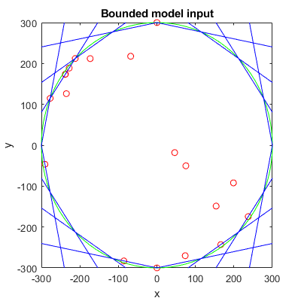
Input bounds
The input bounds are made using linear inequalities to approximate a circle, as can be seen in the image below.

Slide 4
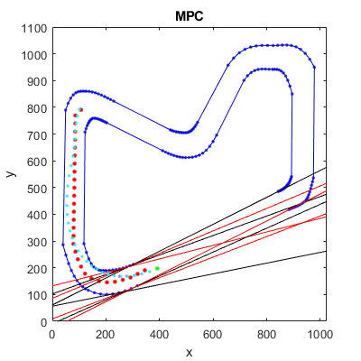
Output bounds
The output bounds are calculated for a part of the MPC horizon. The output bounds consist of linear inequalities which form upper and lower bounds for a number of predicted future positions as can be seen in the image below.

Slide 5
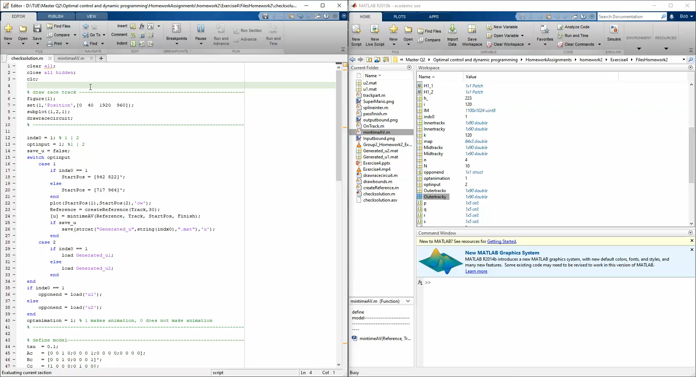
Result

